Slide 1
CGB1221 – DATABASE MANAGEMENT SYSTEM
Department of Artificial Intelligence and Data Science
Academic Year: 2024 – 2025 (Even Semester)
Register Number : 2303811724321117
Name : Thilipkumar S
Year : II Year
Semester : IV
Section : B
Date : 04-06-2025

Slide 2
Project Title
COURIER TRACKING SYSTEM

Slide 3
Problem Identification
Manual Processing: Shipping companies manually update customer details, leading to errors and inefficiency.
Inefficient Shipment Tracking: No central system to track shipments, status updates, and delivery history in real-time.
Customer Communication Gaps: Shipment status or updates are not provided in a structured manner to customers.
Lack of Transparency: Customers often don’t know the current status or location of their shipment.

Slide 4
Objective
To allow customers to track the status of their shipments in real-time.
To automate updates on the progress of shipments (e.g., "In Transit", "Delivered").
To manage customer information efficiently.
To minimize manual data entry and improve customer service by providing accurate shipment tracking information.

Slide 5
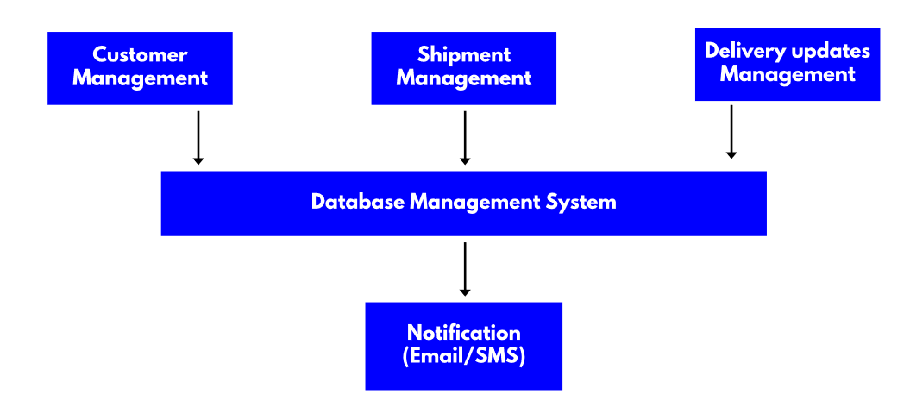
Proposed Architecture

Slide 6
List of Modules
Courier Booking Module
Tracking Module
Admin Authentication & Dashboard Module
Courier Status Update Module
Reporting & Record Viewing Module

Slide 7
Modules Description
Courier Booking Module
Accepts user name, from and to cities, weight, and delivery speed.
Calculates price based on weight and delivery type.
Price and delivery time calculation.
Records the booking date and time automatically.
Saves all booking data securely in the database.

Slide 8
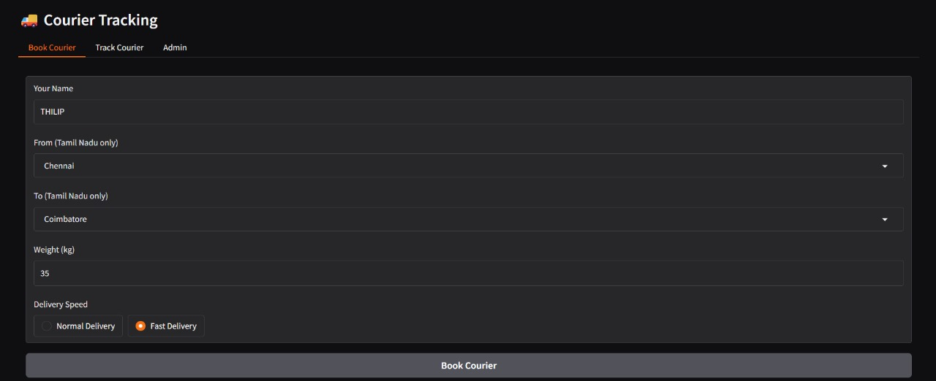
Module Implemented

Slide 9
Modules Description
Tracking Module
Let’s users track their courier using the tracking ID.
Displays sender, route, current location, and estimated days left.
Shows clear tracking info in user-friendly format.
Handles incorrect or invalid tracking IDs.
Uses SQL to fetch data from the courier table.

Slide 10
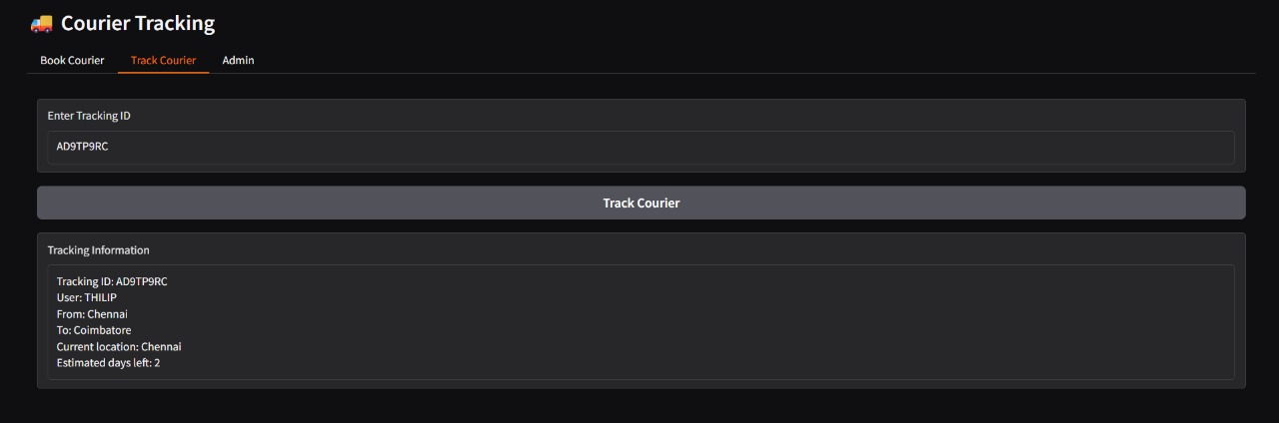
Module Implemented

Slide 11
Modules Description
Admin Authentication & Dashboard Module
Provides login screen for admin with username and password.
Validates admin credentials stored in the database.
Grants access to admin panel only after correct login.
Loads all tracking IDs for quick selection.
Shows login success or error message.

Slide 12
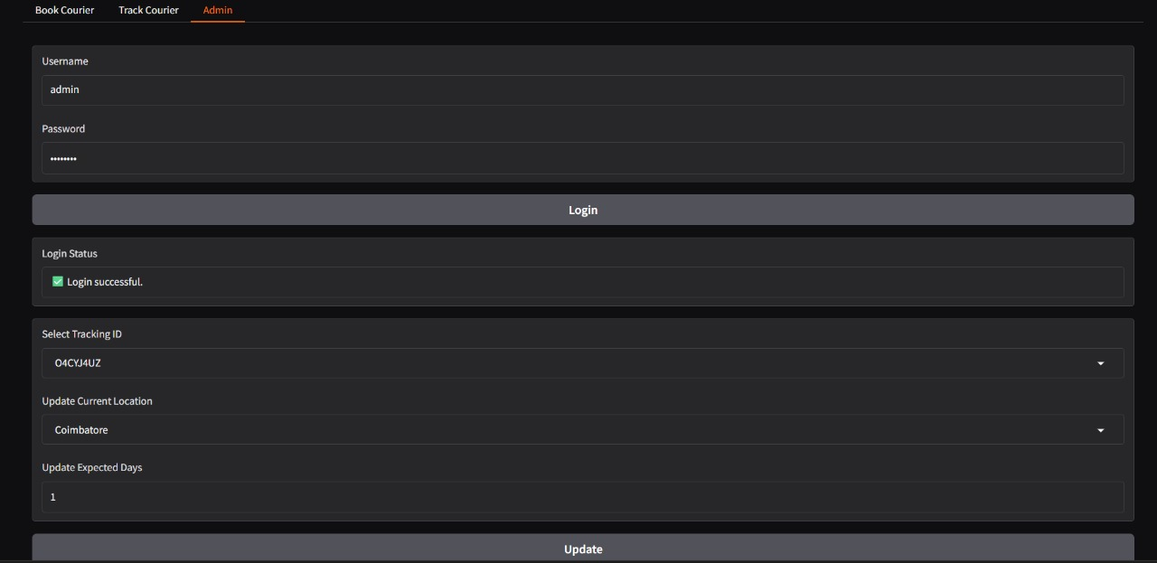
Module Implemented

Slide 13
Modules Description
Courier Status Update Module
Admin can update courier’s current location.
Allows changing estimated delivery days.
Validates location and day inputs.
Updates the database with new status.
Confirms if update was successful.

Slide 14
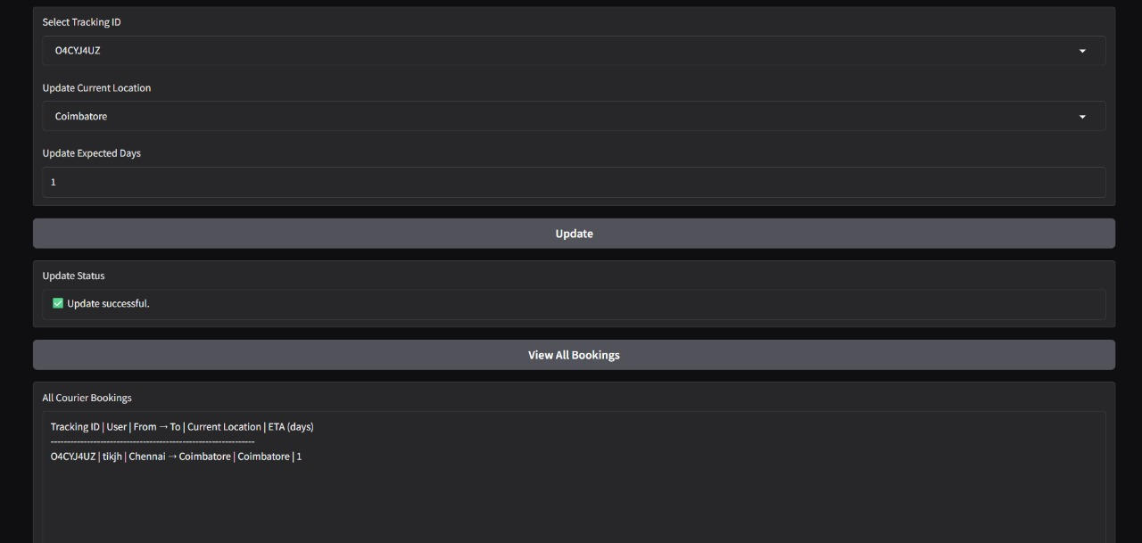
Module Implemented

Slide 15
Modules Description
Reporting & Record Viewing Module
Shows a list of all courier bookings.
Displays tracking ID, user, route, location, and ETA.
Orders records by most recent bookings.
Handles empty data gracefully.
Useful for admin review and reporting.

Slide 16
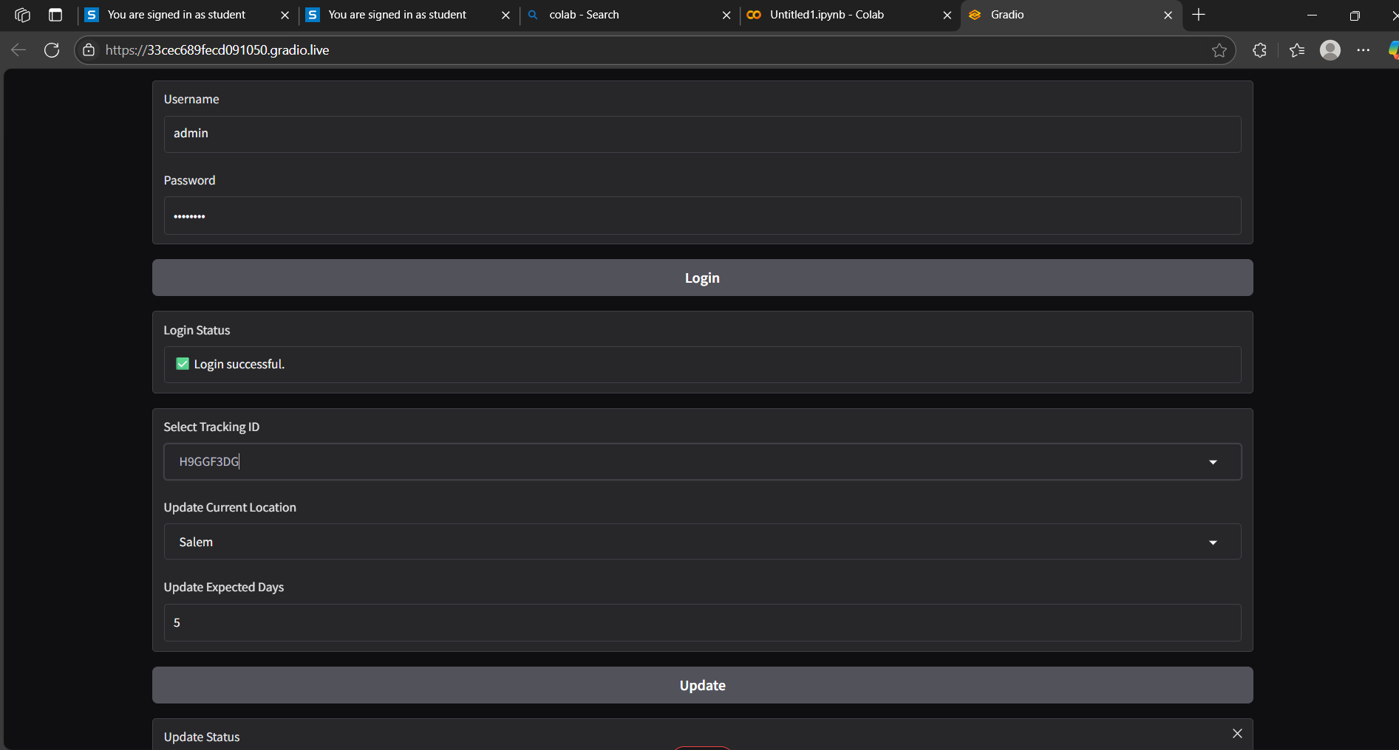
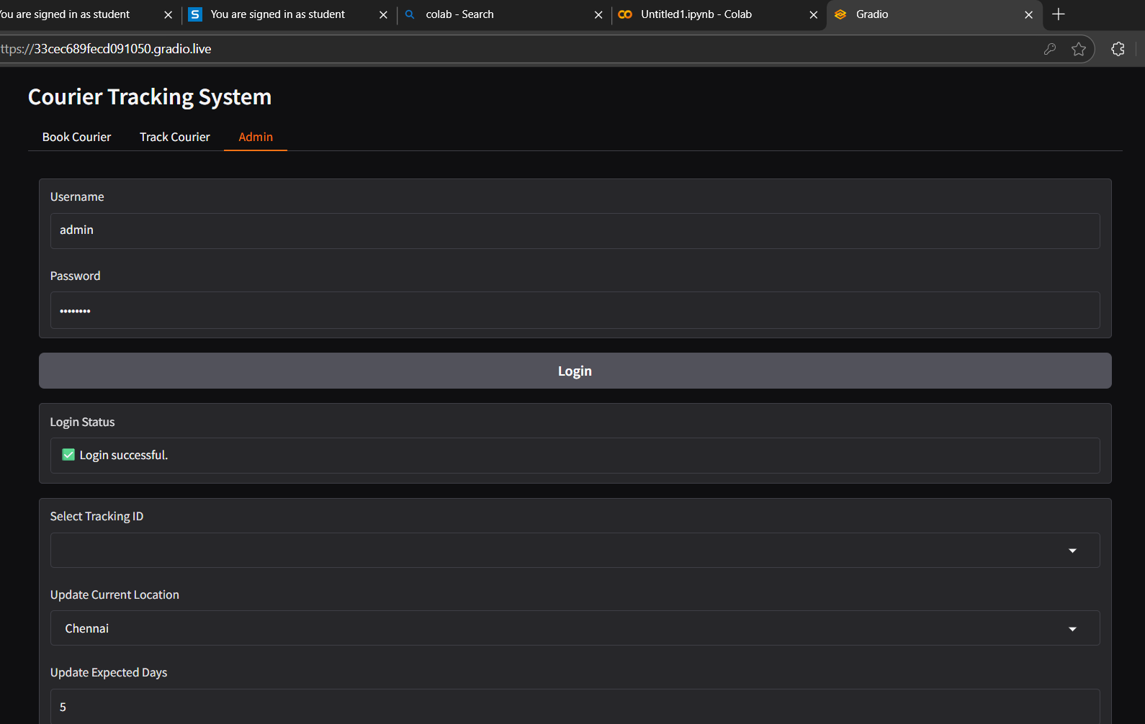
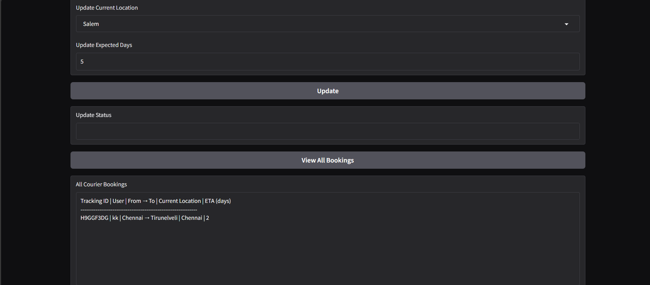
Module Implement

Slide 17
Conclusion
This system is designed to streamline and enhance the efficiency of customer, shipment, and delivery management operations. By integrating real-time updates, secure access, and robust reporting tools, the platform supports seamless logistics tracking and customer service. With modules tailored for user roles, shipment creation, delivery status updates, and detailed analytics, the system not only ensures operational accuracy but also provides valuable insights for decision-making and performance improvement. Overall, it offers a comprehensive solution for managing the end-to-end logistics workflow effectively.

Slide 18
Thank You
ANY QUERIES???

